Slide 1



E-Waste Generation Classification

Slide 2

Learning Objectives
The learning objectives for this project are:
● Data Understanding and Pre-processing
● Exploratory Data Analysis
● Feature Engineering (Implicit via Transfer Learning)
● Machine Learning Algorithm Application (Deep Learning with Transfer Learning)
● Model Training and Evaluation
● Model Deployment (using Gradio)
GOAL
Source :
www.freepik.com/

Slide 3
Tools and Technology used
1. Python :
Used as the primary programming language for data preprocessing, exploratory data analysis, and implementation of machine learning algorithms. Python's libraries, such as numpy, matplotlib, scikit-learn, and others, facilitated efficient data manipulation, visualization, and model development.
2. TensorFlow & Keras :
Used for constructing, training, and fine-tuning deep learning models. The EfficientNetV2S architecture was implemented using Keras within the TensorFlow framework.
3. Pillow (PIL) :
Used for loading image files and performing basic image processing operations (PIL / pillow).

Slide 4
Tools and Technology used
4. Gradio :
Used the gradio library to develop user-friendly web interfaces for deploying and interactively testing machine learning models.
5. Jupyter Notebook :
Used for an interactive and collaborative coding environment. Jupyter Notebook provided a seamless platform for code execution, visualization, and documentation.

Slide 5
Methodology
Data Exploration:
● The project utilized a folder-based image classification dataset comprising images of 10 e-waste categories: PCB, Player, Battery, Microwave, Mobile, Mouse, Printer, Television, Washing Machine, and Keyboard.
● The dataset was organized into three directories:
-Train/: 2,400 images (240 images per class)
- Validation/: 300 images (30 images per class)
-Test/: 300 images (30 images per class)
● All classes are equally balanced across the training, validation, and test sets, ensuring no class bias during model training or evaluation.
● Exploratory data analysis confirmed that each subfolder accurately represented its respective class, and sample image visualizations revealed consistent labeling and distinguishable visual features across categories.

Slide 6
Methodology
Data Preprocessing:
For image data, the preprocessing steps involved:
● Image Resizing and Rescaling: Images were uniformly resized (e.g., 128×128 pixels) and pixel values were rescaled (e.g., 0-255 to 0-1) for consistent model input and improved convergence.
● Data Augmentation: Techniques like RandomFlip, RandomRotation, and RandomZoom were applied to the training data. This expanded the dataset, enhancing feature learning and reducing overfitting.
● Image Normalization: Images were normalized using preprocess_input to match the specific input requirements of the pre-trained EfficientNet model, crucial for effective transfer learning.

Slide 7
Methodology
Model Development :
The e-waste classification model was developed using a transfer learning approach, leveraging the robust features of the pre-trained EfficientNetV2S neural network. This powerful model, initially trained on a massive dataset, served as the backbone, with its top classification layers removed.
A new, custom classification head was then added, consisting of a GlobalAveragePooling2D layer to condense image features, a Dropout layer (with a 20% dropout rate) to prevent the model from memorizing the training data too closely, and a Dense layer with softmax activation to output probabilities for the 10 distinct e-waste categories. An explicit Input layer defined the expected image size of 128×128 pixels.
The training strategy involved a crucial fine-tuning step. While the entire EfficientNetV2S backbone was initially set to be trainable, the first 100 layers were then specifically frozen. This allowed the model to retain the generalized low-level features learned from ImageNet, while enabling the higher-level features and the newly added classification head to adapt and learn patterns specific to the e-waste images.

Slide 8
Methodology
The model was then compiled using the Adam optimizer with a learning rate of 0.0001, which is a common and effective choice for deep learning. SparseCategoricalCrossentropy was chosen as the loss function, suitable for multi-class classification problems where labels are integers, and Accuracy was set as the primary metric to track performance during training.
The model was trained for a maximum of 10 epochs, processing images in batches of 100. To ensure efficient training and prevent overfitting, an EarlyStopping callback was implemented.
This callback continuously monitored the val_loss (validation loss). If the validation loss did not show improvement for 3 consecutive epochs (patience=3), training would automatically stop. Furthermore, restore_best_weights=True ensured that the model's weights from the epoch with the lowest validation loss were preserved, guaranteeing that the final saved model was the best-performing version on unseen data. This comprehensive setup aimed to achieve high classification accuracy and strong generalization for the e-waste sorting task.

Slide 9
Methodology
Evaluation :
Over 10 training epochs, the model exhibited rapid learning and strong performance, achieving high training accuracy (0.9843) and consistent validation accuracy (0.9667).
The final evaluation on the unseen test dataset confirmed the model's robustness, yielding a high test accuracy of 0.9467 and a low test loss of 0.1738. Detailed analysis through the classification report and confusion matrix further demonstrated excellent precision, recall, and F1-scores across all 10 distinct e-waste categories, indicating the model's strong generalization capabilities and effectiveness in differentiating various electronic waste types.
Key Points derived from the classification report:
● High Overall Accuracy
● Excellent Performance for Specific Classes
● Robust Performance Across All Classes
● Balanced Test Set
● Strong Generalization

Slide 10
Problem Statement:
Electronic waste (e-waste) is a rapidly growing global concern for both environmental and public health. Discarded electronic devices contain both valuable resources and hazardous substances, leading to contamination and health risks if improperly processed. Manual classification for recycling is labor-intensive, prone to errors, and inefficient. This project aims to establish an automated e-waste classification system using artificial intelligence and machine learning, enabling accurate and rapid identification to streamline recycling and promote sustainable waste management.

Slide 11
Solution:
To solve the problem of E-Waste Generation Classification, we develop a highly accurate and dependable E-Waste Image Classification model for categorizing electronic waste based on visual data. This advanced model will leverage transfer learning with the EfficientNetV2S algorithm, a state-of-the-art convolutional neural network. Automating e-waste identification will facilitate efficient sorting and recycling, representing a pivotal advancement towards a circular economy for electronics, promoting environmental stewardship, and safeguarding public health.
This project aims to develop an automated e-waste classification system using advanced deep learning techniques, specifically leveraging EfficientNetV2S. By accurately categorizing electronic waste from images, the model will streamline sorting processes for efficient recycling. This initiative seeks to mitigate environmental and health risks associated with improper e-waste disposal. This is a reliable tool that contributes significantly to sustainable waste management and environmental protection.

Slide 12
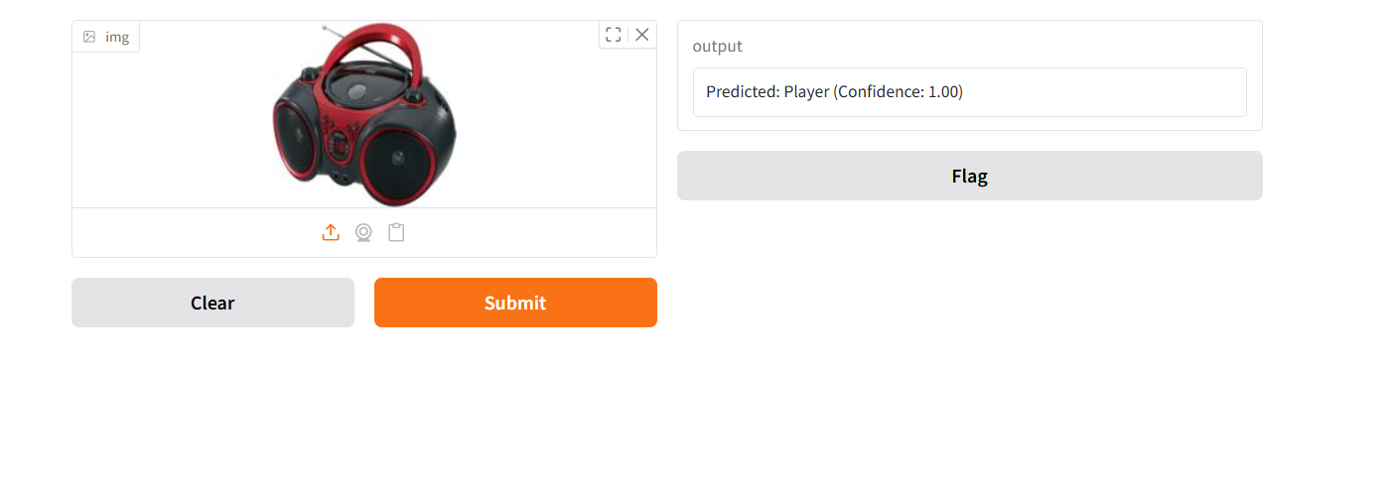
Screenshot of Output:

Slide 13
Conclusion:
This project successfully developed an accurate and reliable E-Waste Image Classification model utilizing EfficientNetV2S and transfer learning techniques. The model demonstrated strong performance across both training and testing phases, achieving high accuracy and robust classification metrics for all 10 distinct e-waste categories, indicating its excellent ability to generalize to new, unseen image data.
The project highlights the efficiency of transfer learning for image classification, especially with limited datasets, and the efficiency of the EfficientNetV2S architecture. The developed model, coupled with its user-friendly Gradio interface, can serve as a valuable tool for automating e-waste sorting, thereby supporting efficient recycling processes and promoting sustainable waste management efforts. Further enhancements could involve advanced hyperparameter tuning or exploring alternative EfficientNetV2 variants for even greater robustness.

